Slide 1
Mathematical finance project
Mohammad navid fazly
Mahdi salahshour

Slide 2
Neural networks for American options pricing

Slide 3
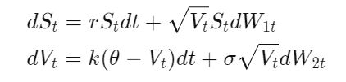
Bloomberg is not available? Well its time to generate data

Slide 4
Intro to neural networks

Slide 5
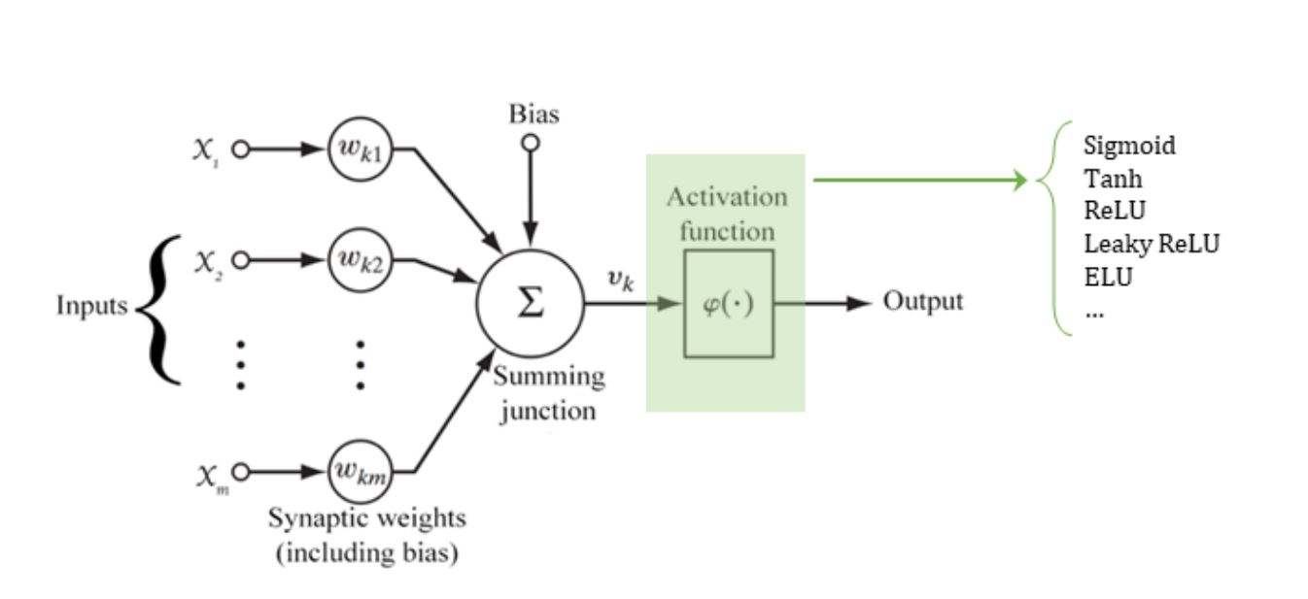
neural NETWORK Structre

Slide 6
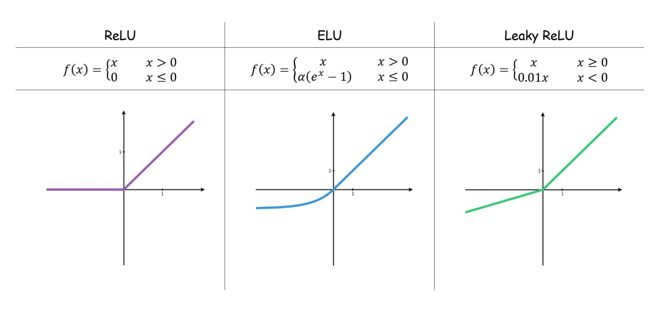
Popular Activation functions

Slide 7
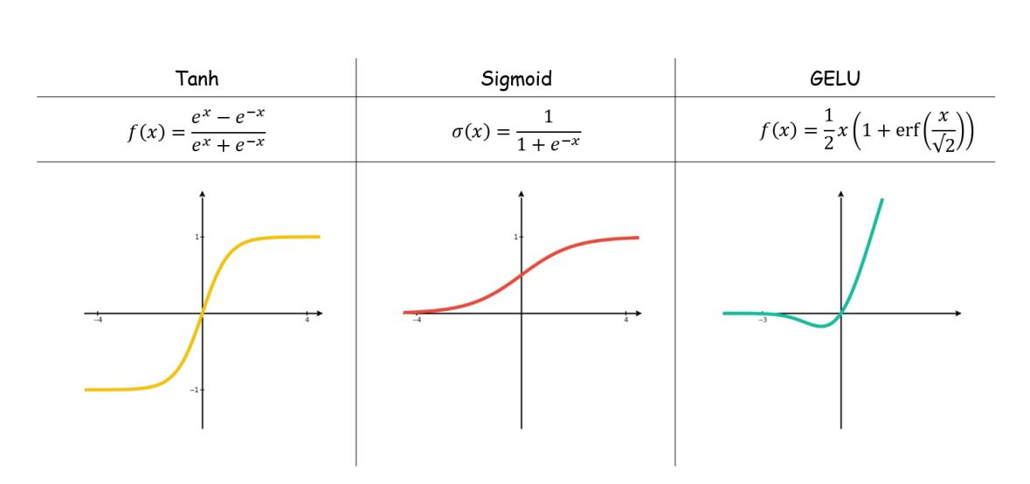

Slide 8
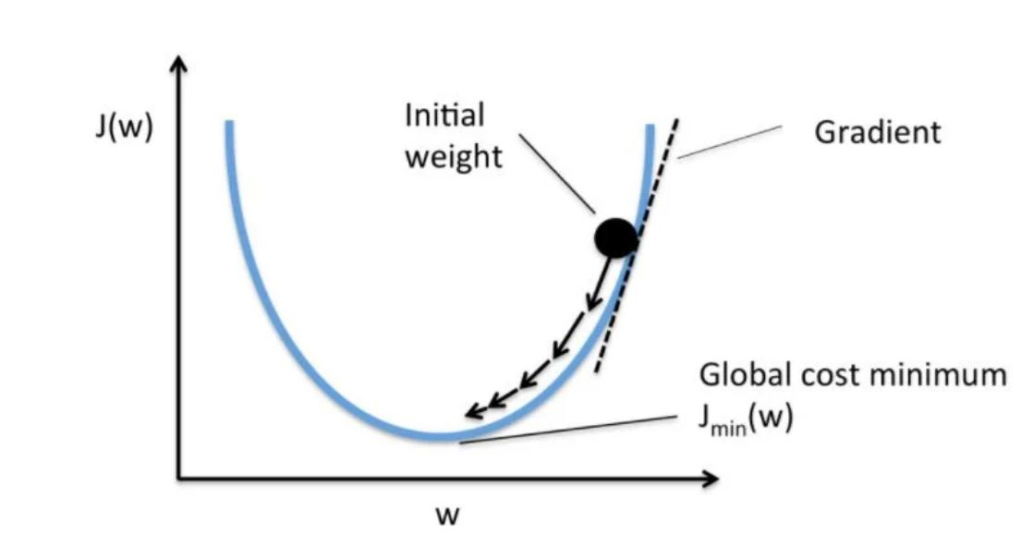
Gradient descent overview

Slide 9
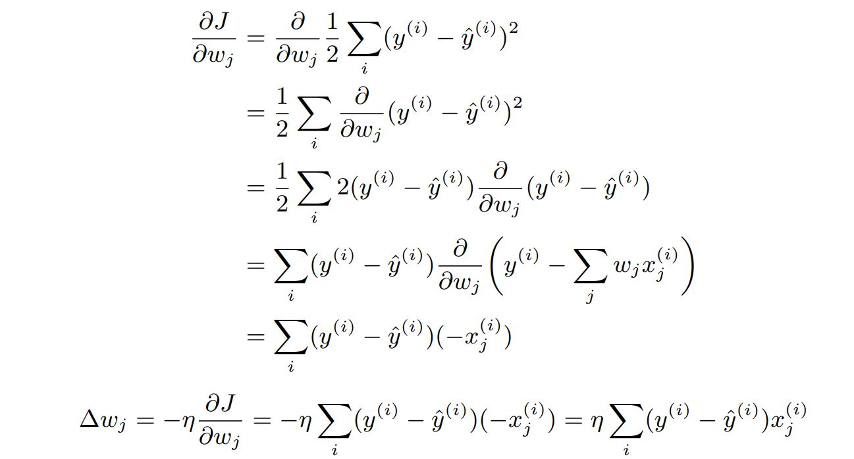
More mathematical computations

Slide 10
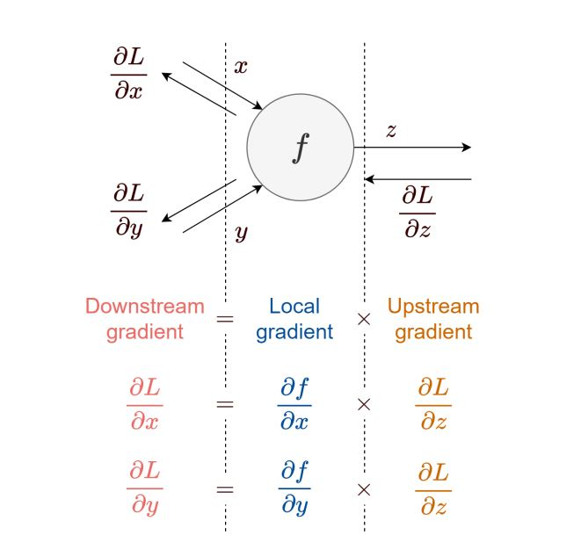
Forward and backward propagation

Slide 11
Lsm, a new approach to monte carlo

Slide 12
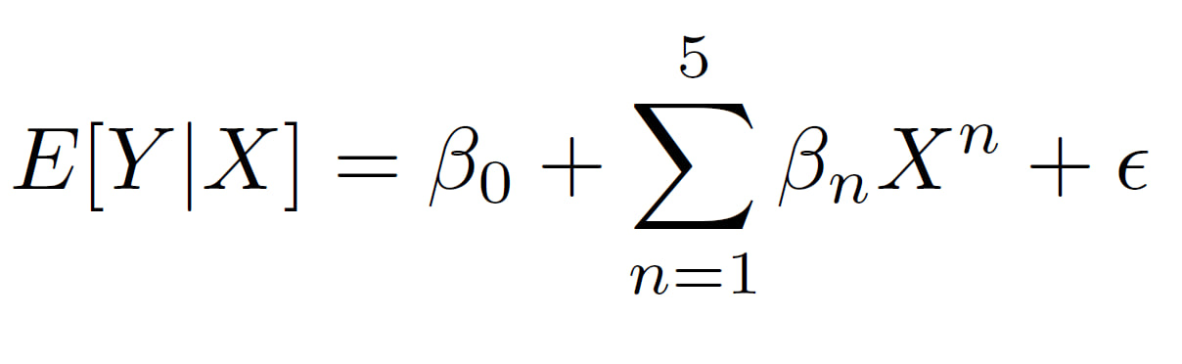
LSM SPECIFICATION
1000 path
50 period
5 degree polynomial

Slide 13
NN1 Model specification
1 layer
9 neuron inputs
Random initial weight with normal distribution with mean zero and std 0.5
Activation function: leaky relu(a=0.1)
Batch size: 64
Epochs: 200
Comparison metric: mse
Normalize output
Learning rate 0.005 with decay per epoch of 1e-6

Slide 14
NN2 Model specification
3 layer
16, 8, 4 neurons inputs in layer1, 2, 3
Random initial weight with normal distribution with mean zero and std 0.5
Activation function: leaky relu(a=0.1)
Batch size: 64
Epochs: 300
Comparison metric: mse
Normalize output
Learning rate 0.005 with decay per epoch of 1e-6

Slide 15
Neural network a better approach

Slide 16
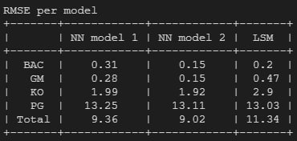
rmse comparison table

Slide 17
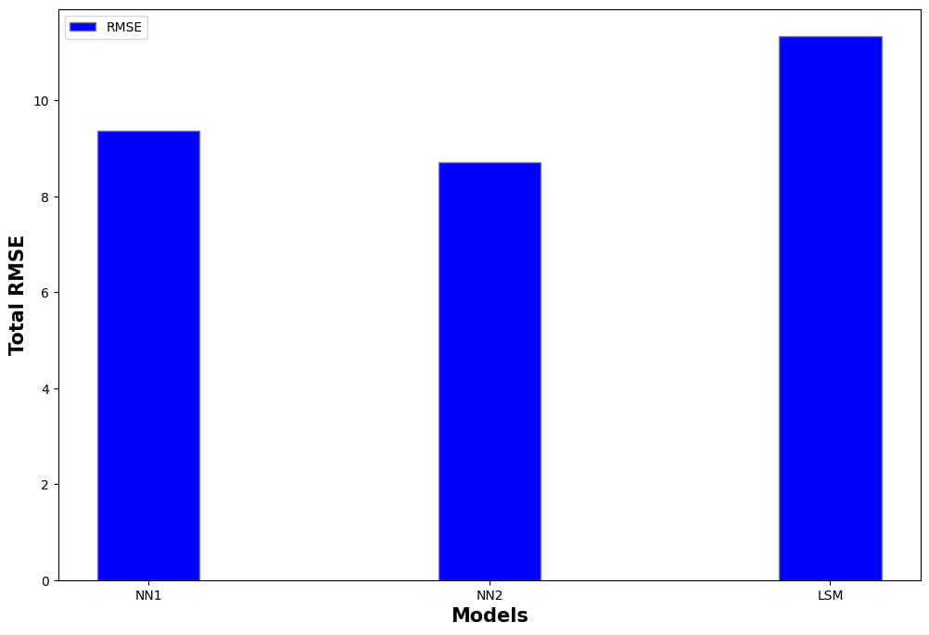
Total rmse comparison chart

Slide 18
